Slide 1
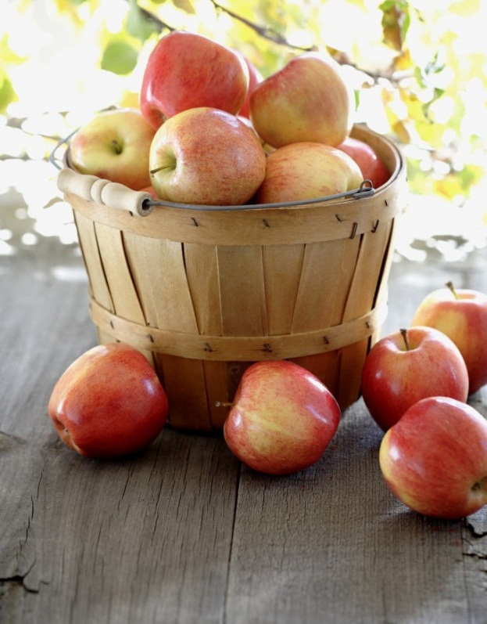
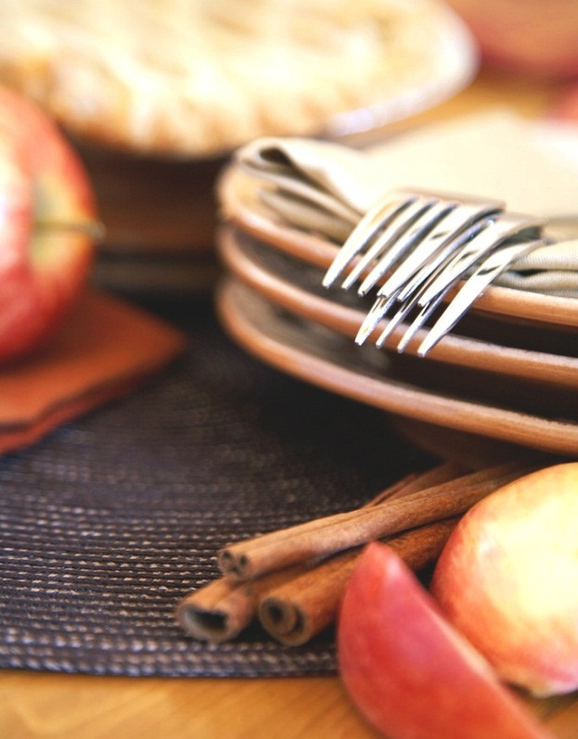
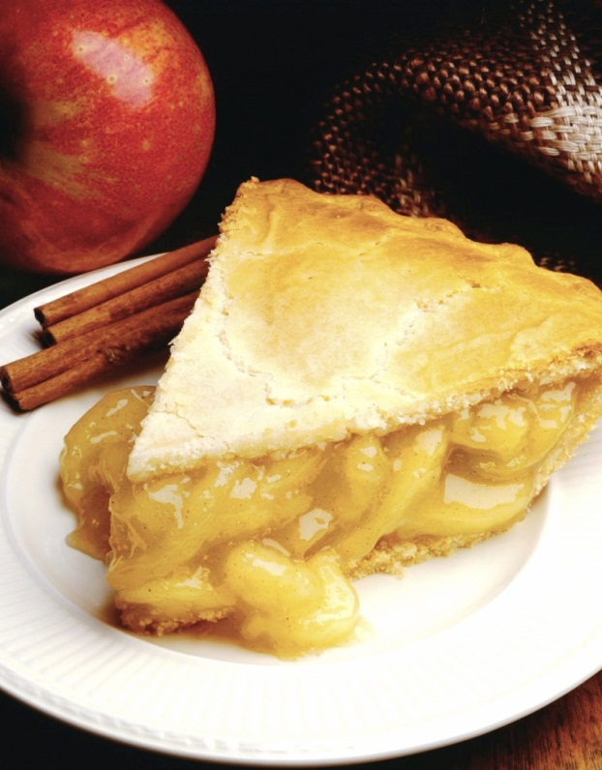
Zomato
Restaurants in India
Notes:
NOTE: To replace a picture, just select and delete it. Then use the Insert Picture icon to replace it with one of your own!

Slide 2
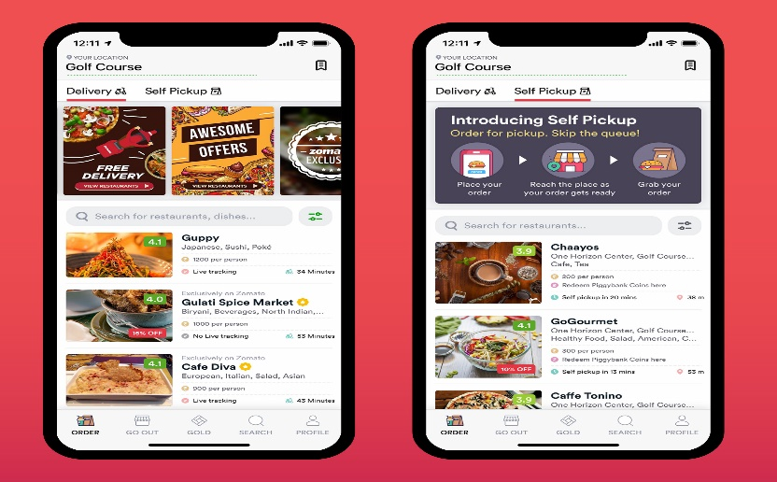
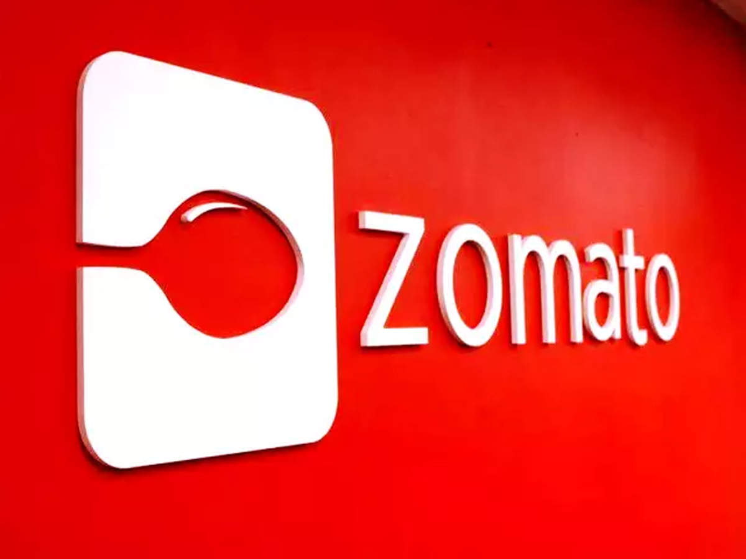
What is Zomato?
Zomato is an Indian restaurant aggregator and food delivery start-up founded by Pankaj Chaddah and Deepinder Goyal in 2008.
It provides information, menus and user-reviews of restaurants as well as food delivery options from partner restaurants in selected cities.
Zomato was founded as Foodiebay in 2008, and was renamed Zomato on 18 January 2010 as Zomato Media Pvt. Ltd.
Zomato has grown from a home project to one of the largest food aggregators in the world.
Zomato is present in 24 countries and 10000+ cities globally, enabling its vision of better food for more people.

Slide 3
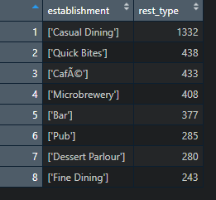
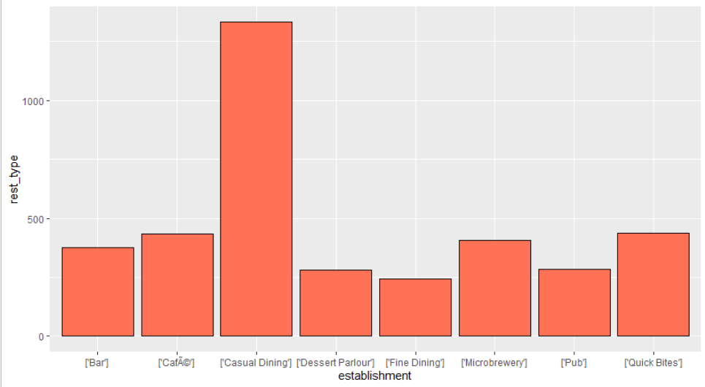
Analysis & Visualization
1.What are the most popular restaurants type around Bangalore?

Slide 4
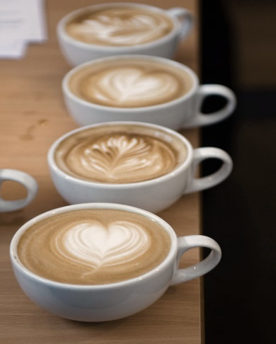
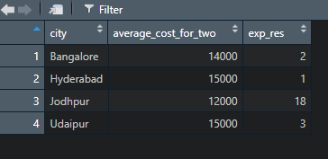
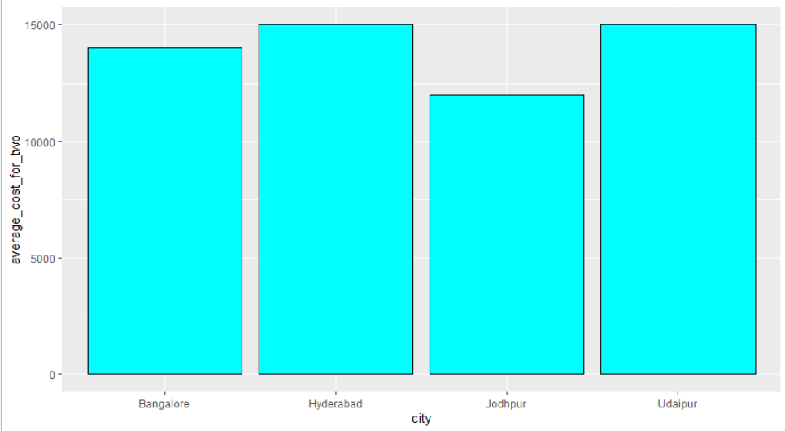
2.Which city has the most expensive restaurants?

Slide 5

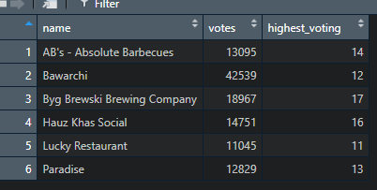
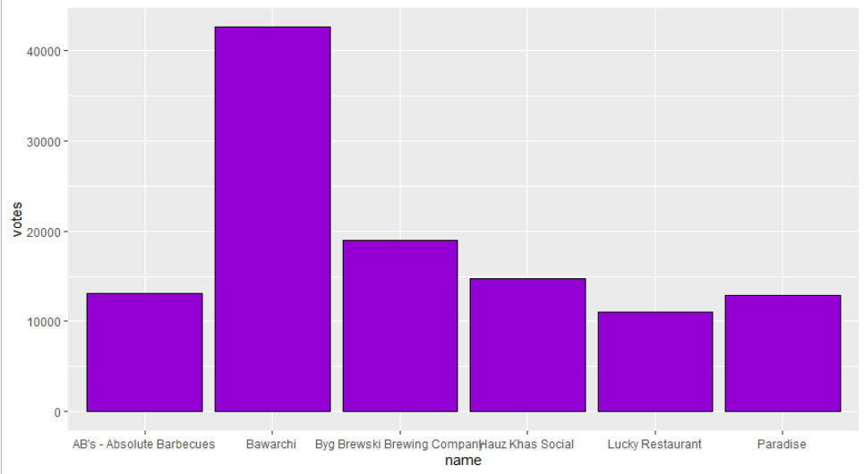
3.Which restaurant has the largest number of votes from the customers?

Slide 6
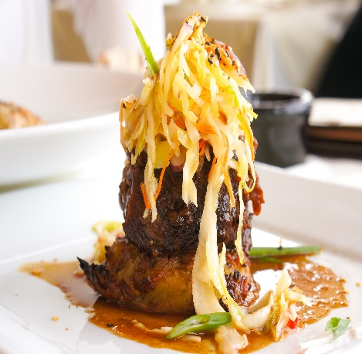
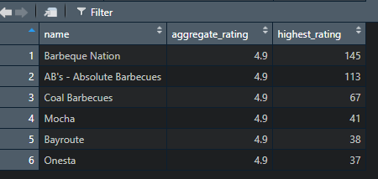
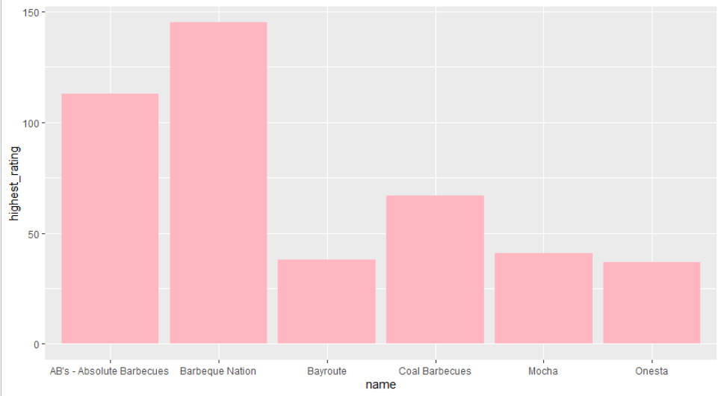
4.Which restaurant have received highest rating in the city?

Slide 7
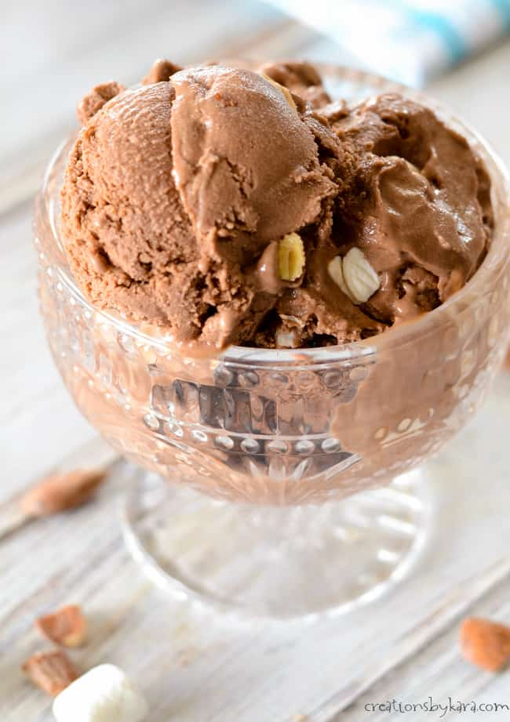
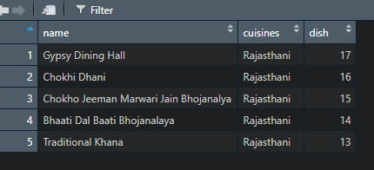
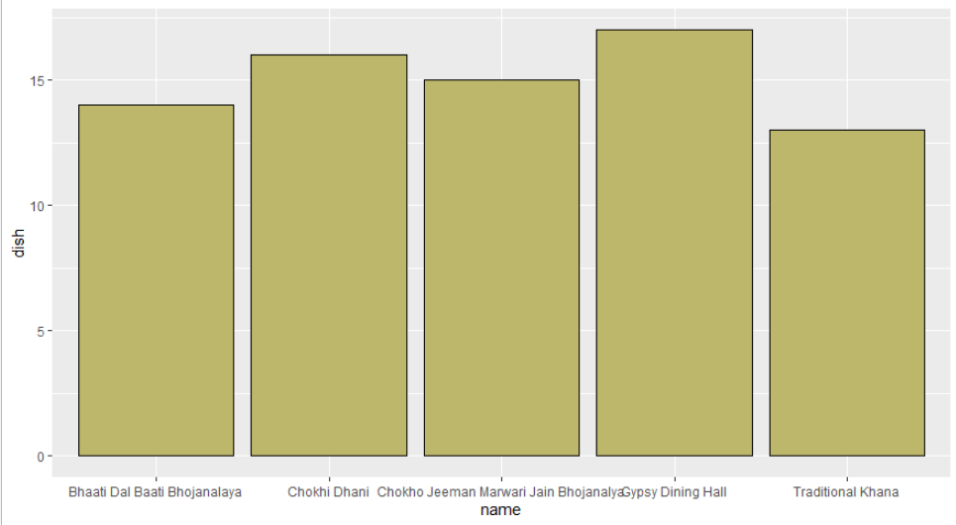
5.Which Restaurant serve Rajasthani dishes ?

Slide 8
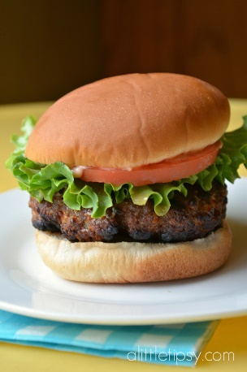
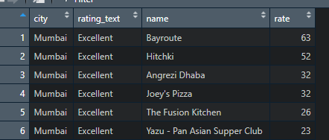
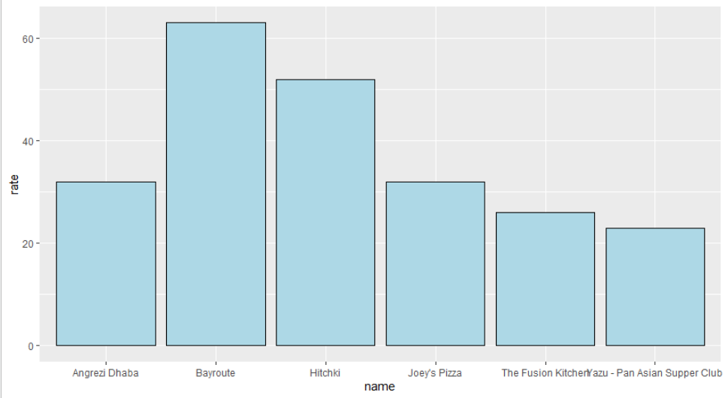
6. Which of the Restaurants in Mumbai come under Excellent Category ?

Slide 9

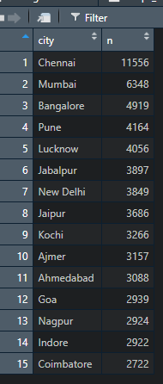
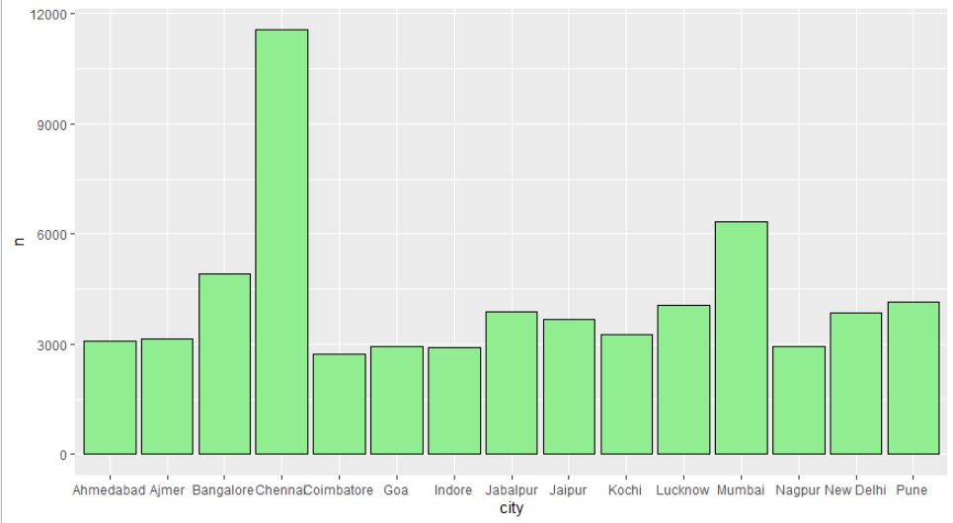
7.Which city has highest number of restaurants registered on zomato in Descending Order ?

Slide 10
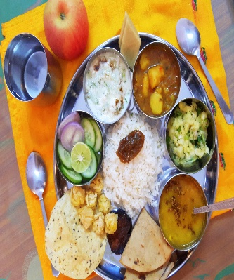
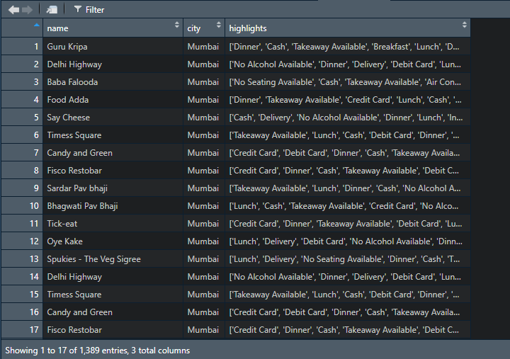
8. Which restaurants in Mumbai serves Pure veg?

Slide 11
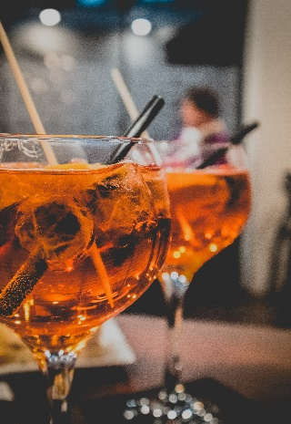
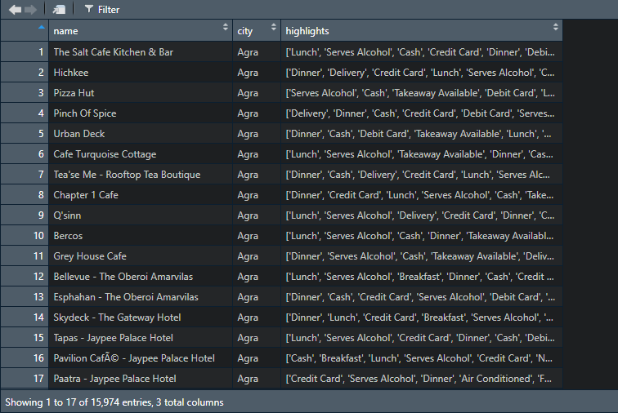
9. Which restaurants serves Alcohol?

Slide 12
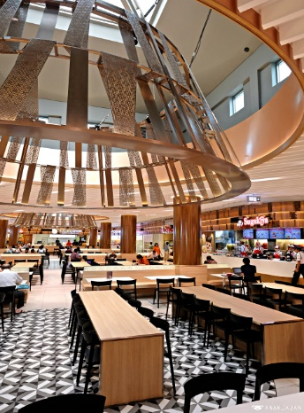
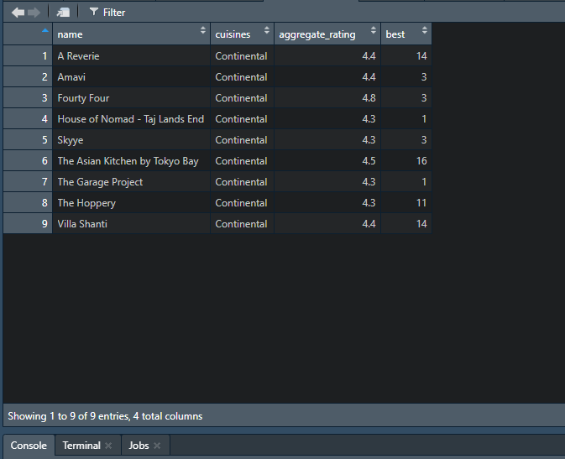
10. Which restaurant serve best continental dishes?

Slide 13
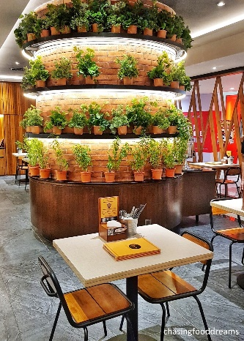
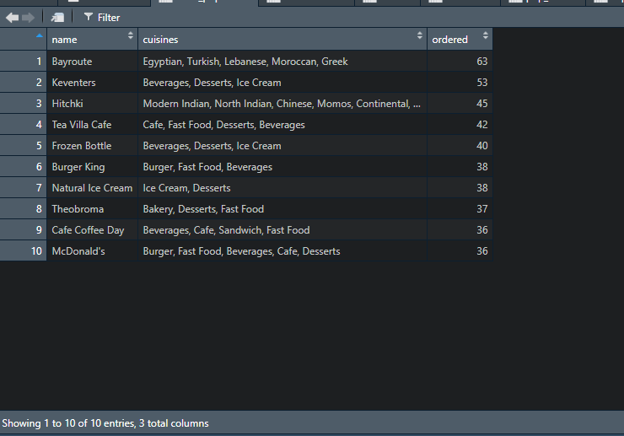
11.What is the most popular food in Mumbai?

Slide 14
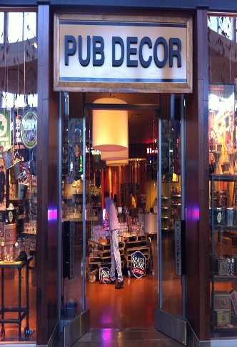
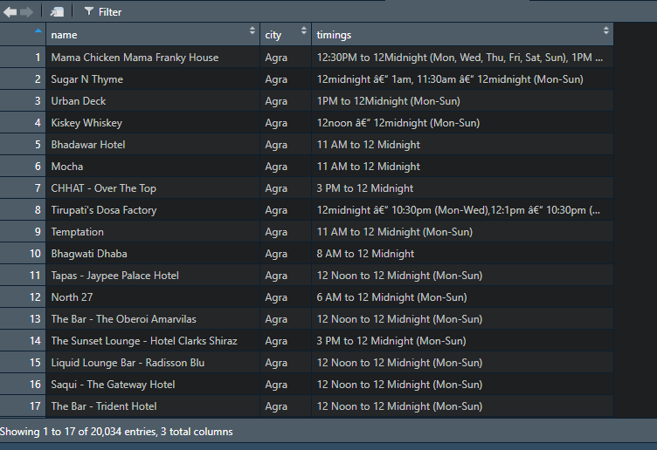
12. Which restaurants are working at midnight?

Slide 15
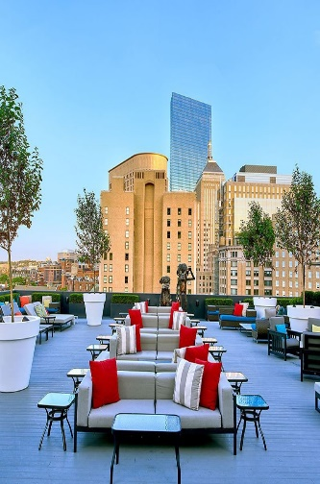
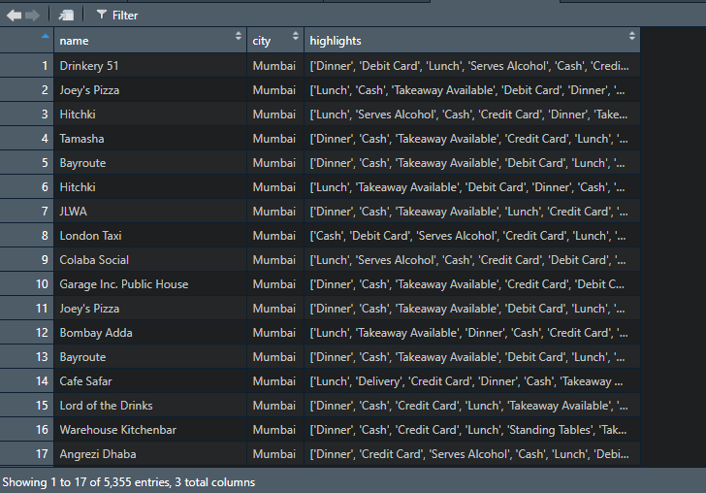
13. Which restaurants in Mumbai have Indoor Seating?

Slide 16

Thankyou !!

